Slide 1
The Scrum-Agile Team
Scrum Master – the facilitator for an Agile development team
Product Owner – responsible for the project's outcome
Developers – the other team members (programmers, testers, etc.)

Slide 2
Stages in Scrum-Agile Software Development
Initiation – This is shown in the meeting between the product owner, scrum master, and the client. Also in the focus group with the users to determine product backlog
Sprint Planning – This was shown when there was a change in the application
Implementing the Sprint – Includes the daily scrum meeting
Reviewing – Lead by the scrum master at the end of the sprint for everyone involved
Retrospective – Lead by the scrum master at the end of the sprint for just the development team
Iterate steps 2 – 5 as many times as needed until the project is finished

Slide 3
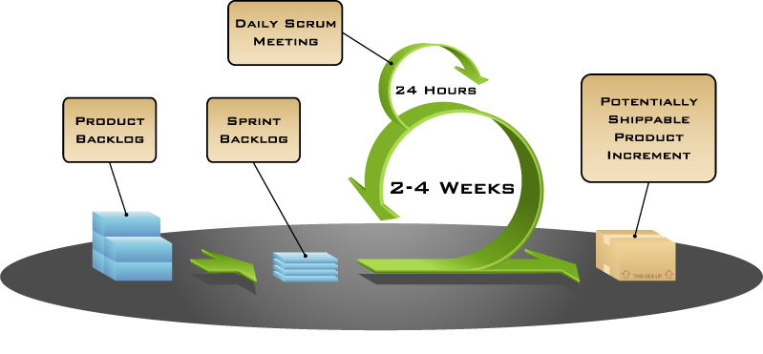
Diagram of Scrum Workflow
Mountain Goat Software, CC BY 2.5 <https://creativecommons.org/licenses/by/2.5>, via Wikimedia Commons

Slide 4
Waterfall Project Management
Follows very specific, well defined steps
Once a step is done, there is no going back
Not ideal for a project with unknowns
Does not allow for change once it has started
Testing is not done until later on, so there is no way to tell if it works until later in the development cycle
In the SNHU Travel application, the switch to health and wellness travel would have been impossible without having to start over again using the waterfall method

Slide 5
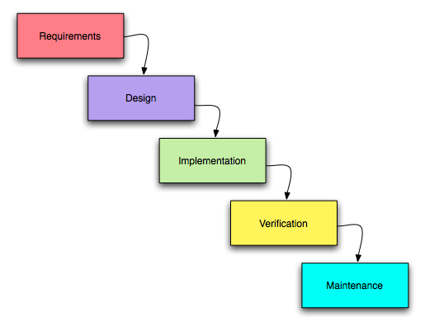
Software Development with Waterfall
The original uploader was PaulHoadley at English Wikipedia., CC BY-SA 2.5 <https://creativecommons.org/licenses/by-sa/2.5>, via Wikimedia Commons

Slide 6
Method Considerations
Waterfall would be good for a project with no unknowns. If you can plan the entire project in advance and not have to worry about the client changing anything then the waterfall method is a great option to use.
Scrum-agile is far better suited for when a project has unknowns, such as ongoing client input or an exploritory project. It is good for being able to fail fast and not waste time going down a road to nowhere by taking the hardest and most likely to fail parts first to reduce time spent and go to a different approach.

Slide 7
Sources
Mountain Goat Software, CC BY 2.5 <https://creativecommons.org/licenses/by/2.5>, via Wikimedia Commons
The original uploader was PaulHoadley at English Wikipedia., CC BY-SA 2.5 <https://creativecommons.org/licenses/by-sa/2.5>, via Wikimedia Commons

